Slide 1

Machine Learning Regularization
Indian Institute of Information Technology Sri City, Chittoor

Slide 2
Today’s Agenda
Regularization

Slide 3
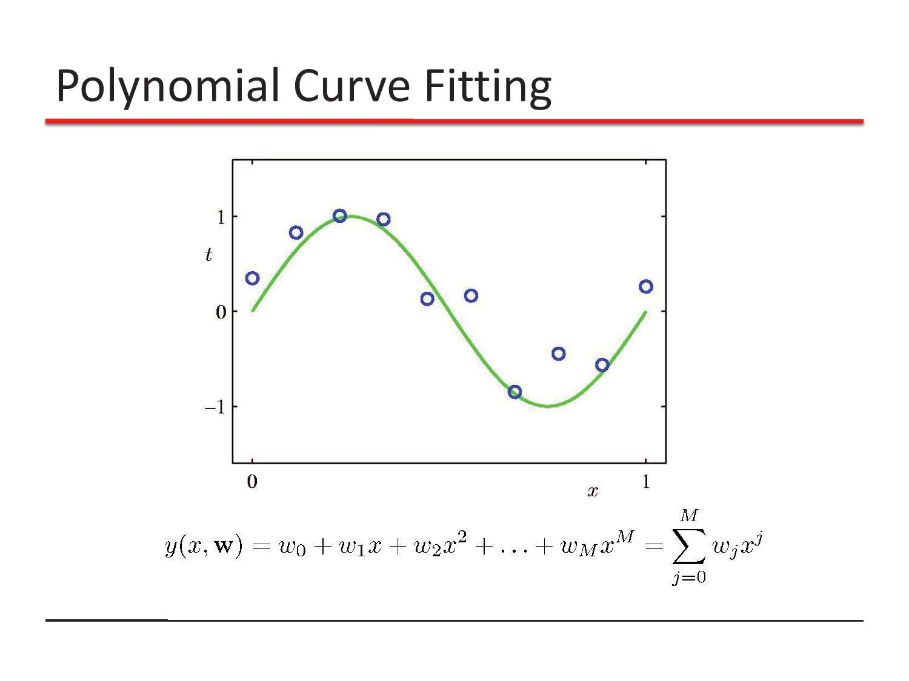

Slide 4
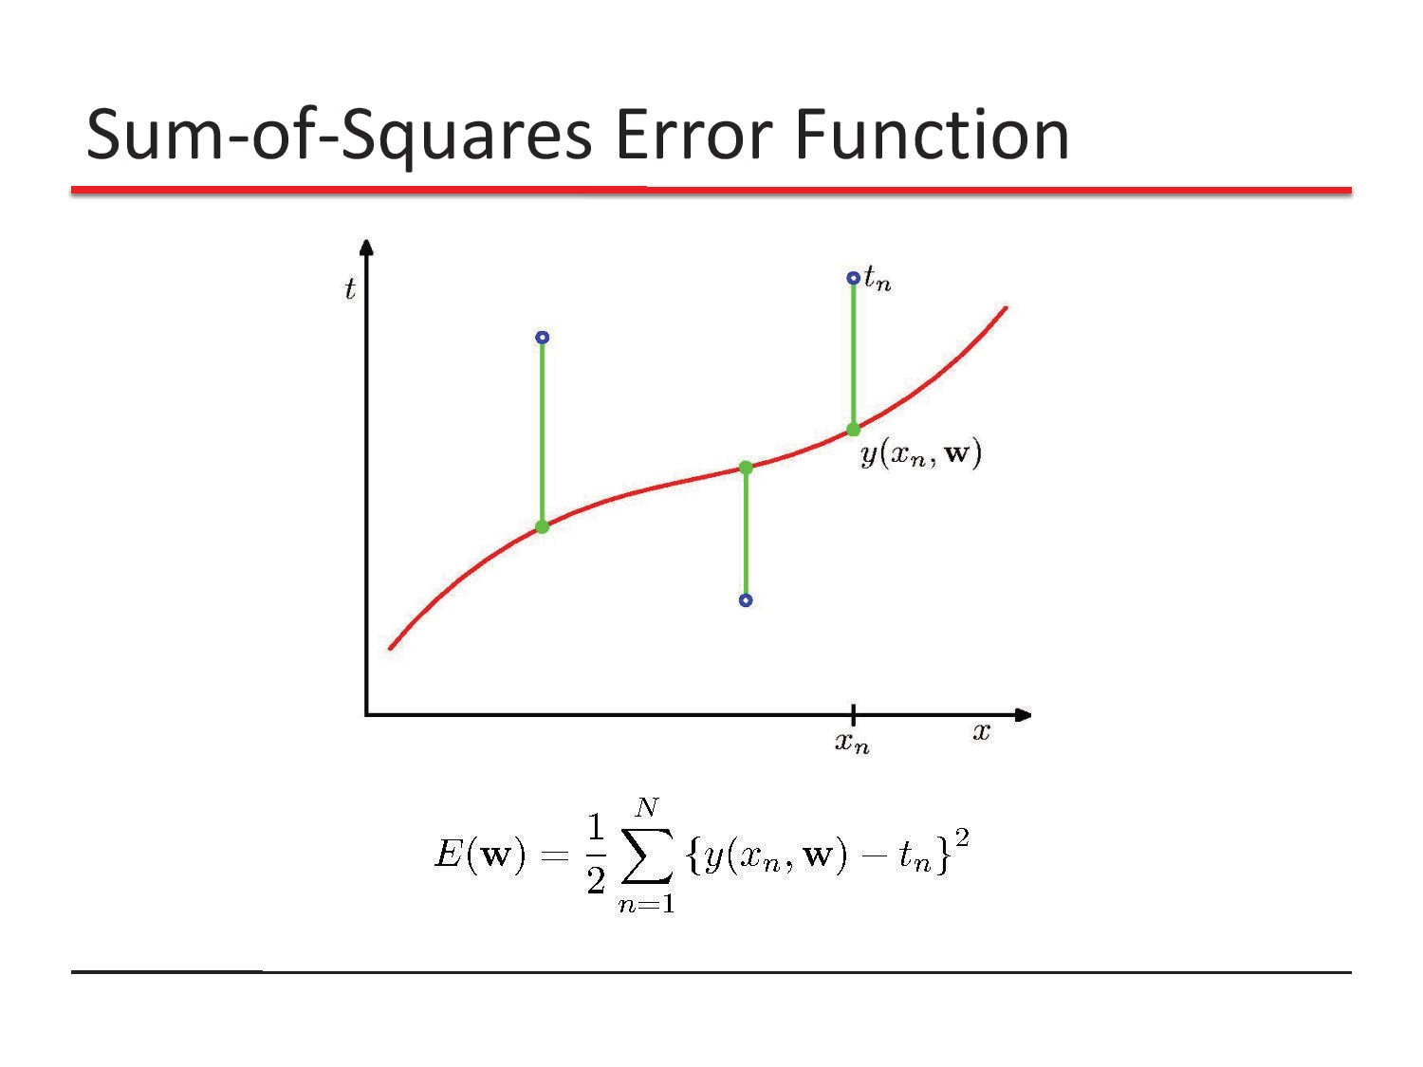

Slide 5
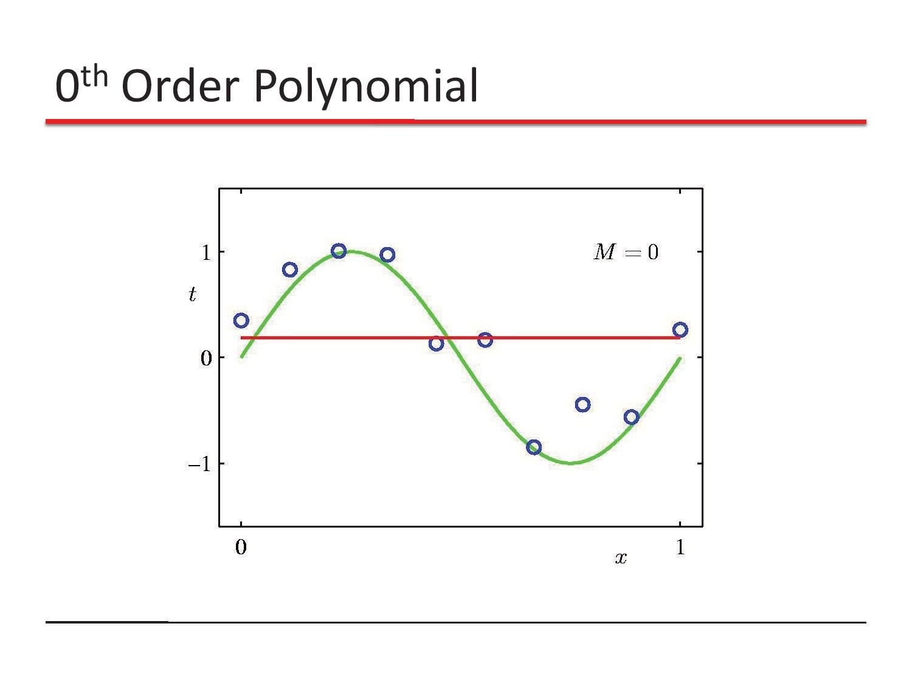

Slide 6
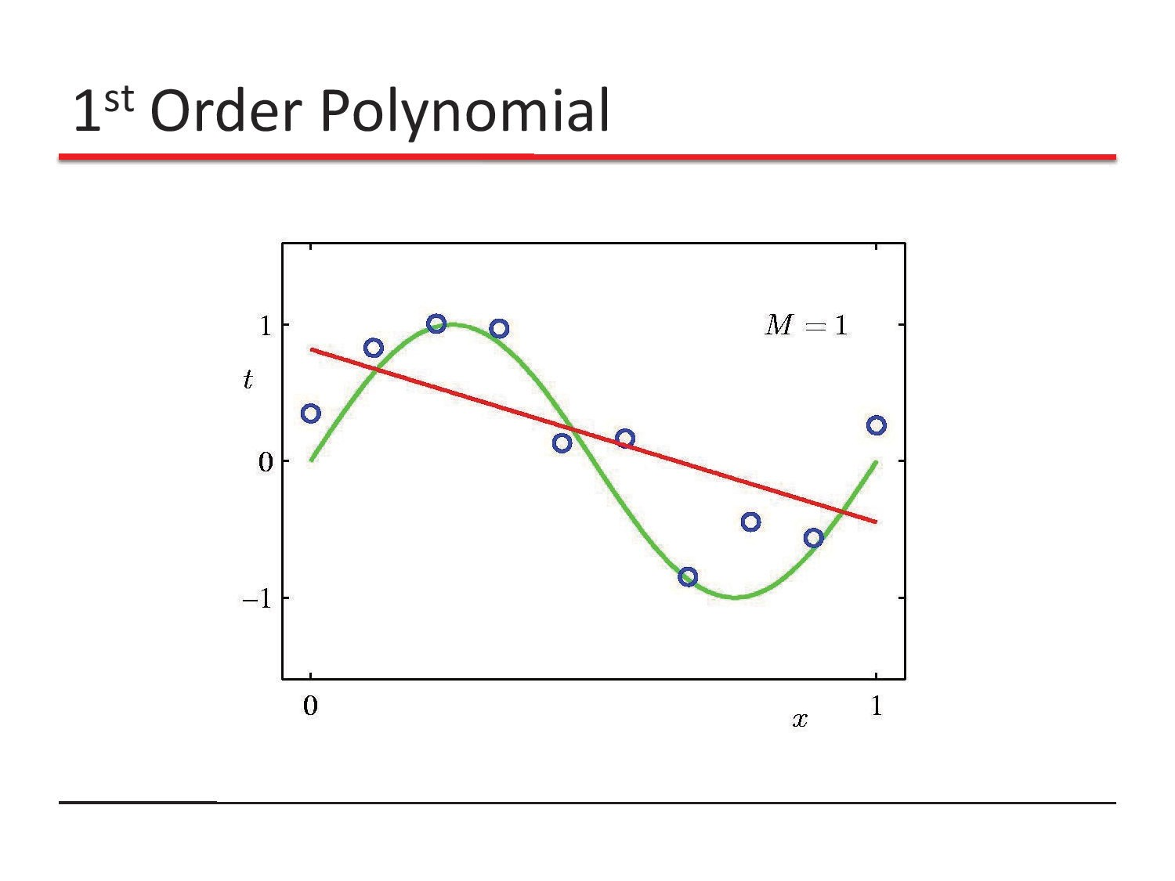

Slide 7
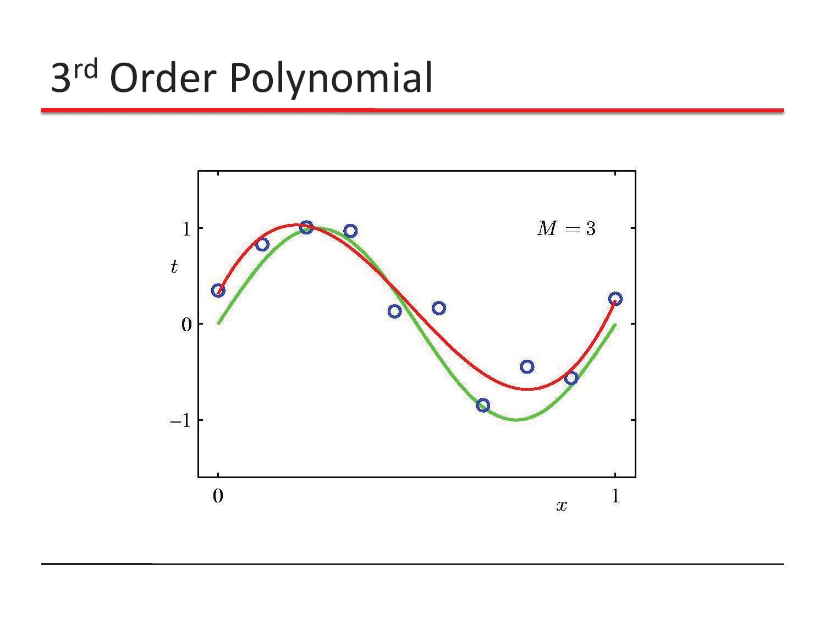

Slide 8
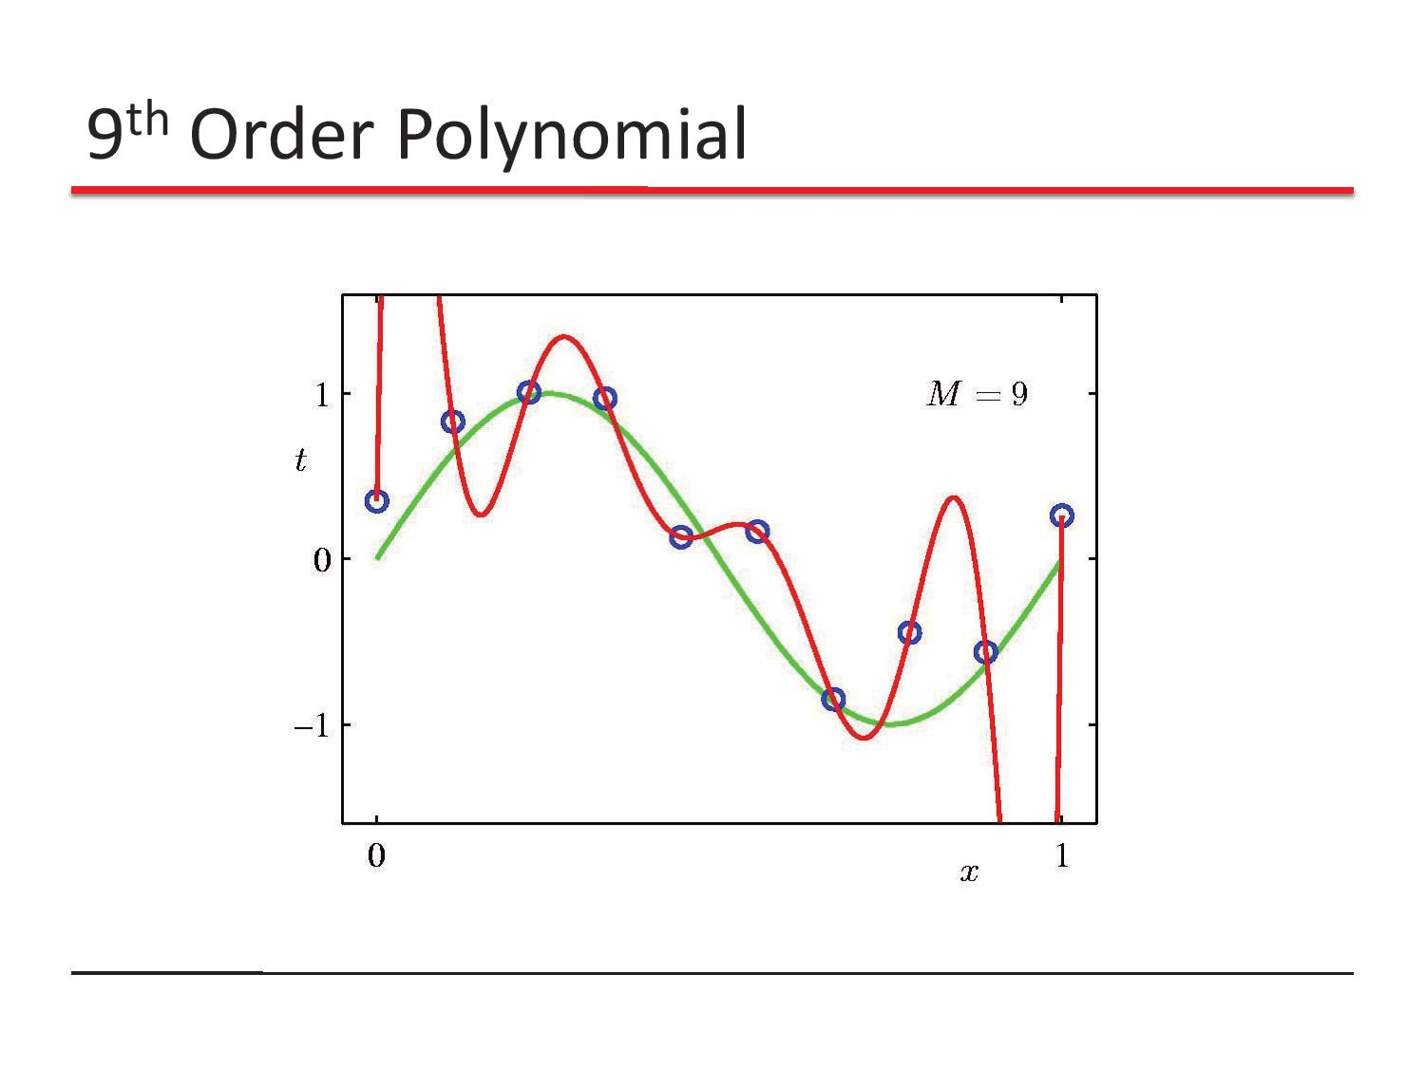

Slide 9
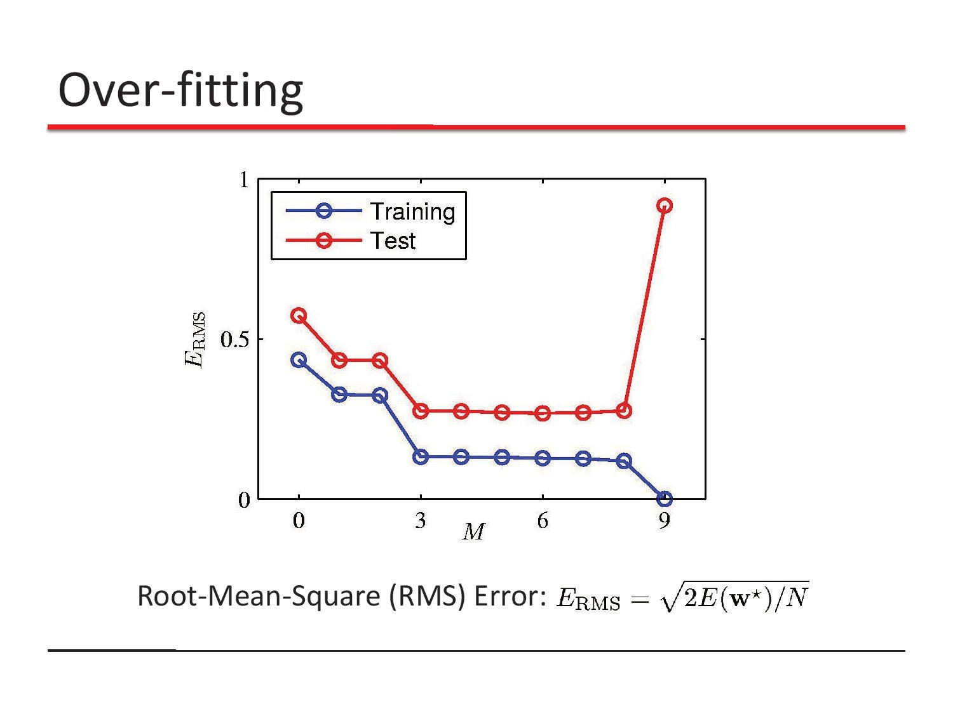

Slide 10
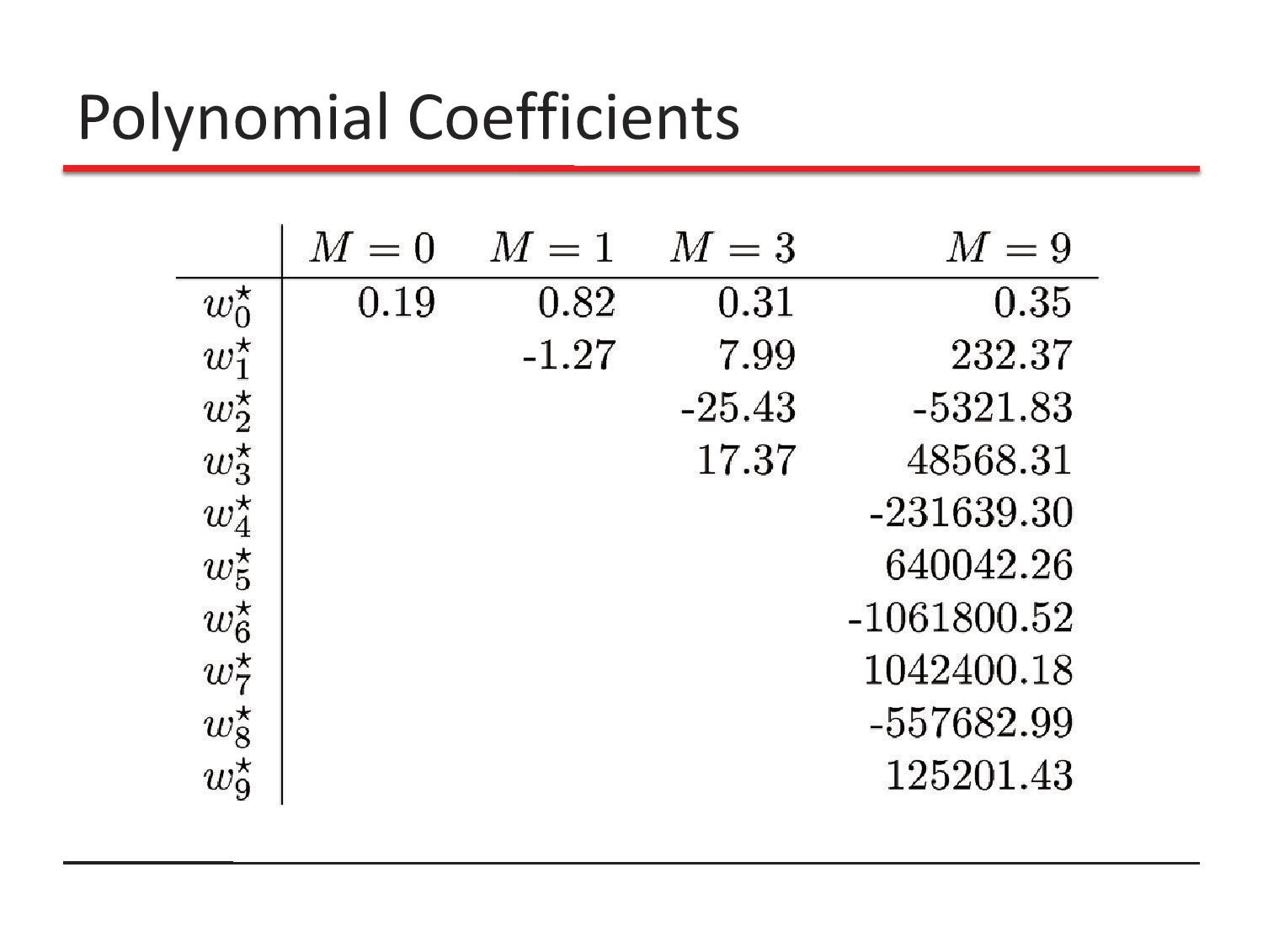

Slide 11
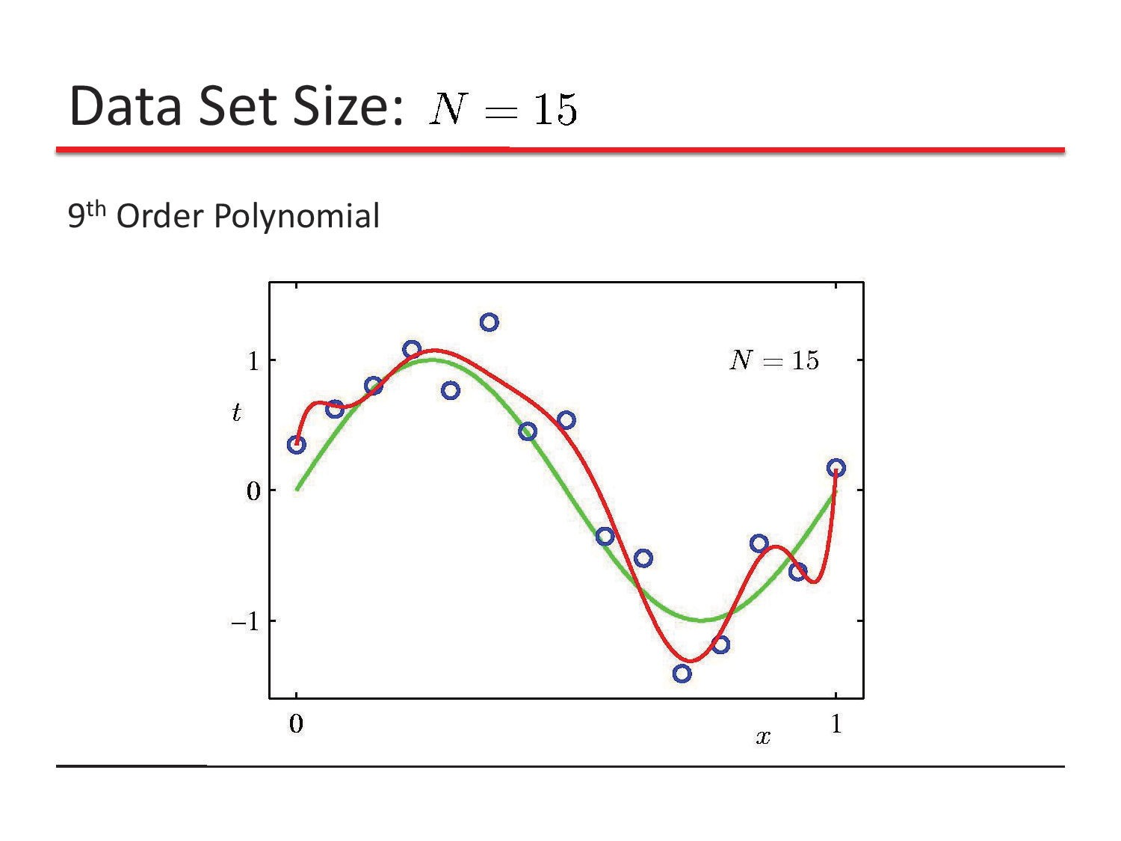

Slide 12
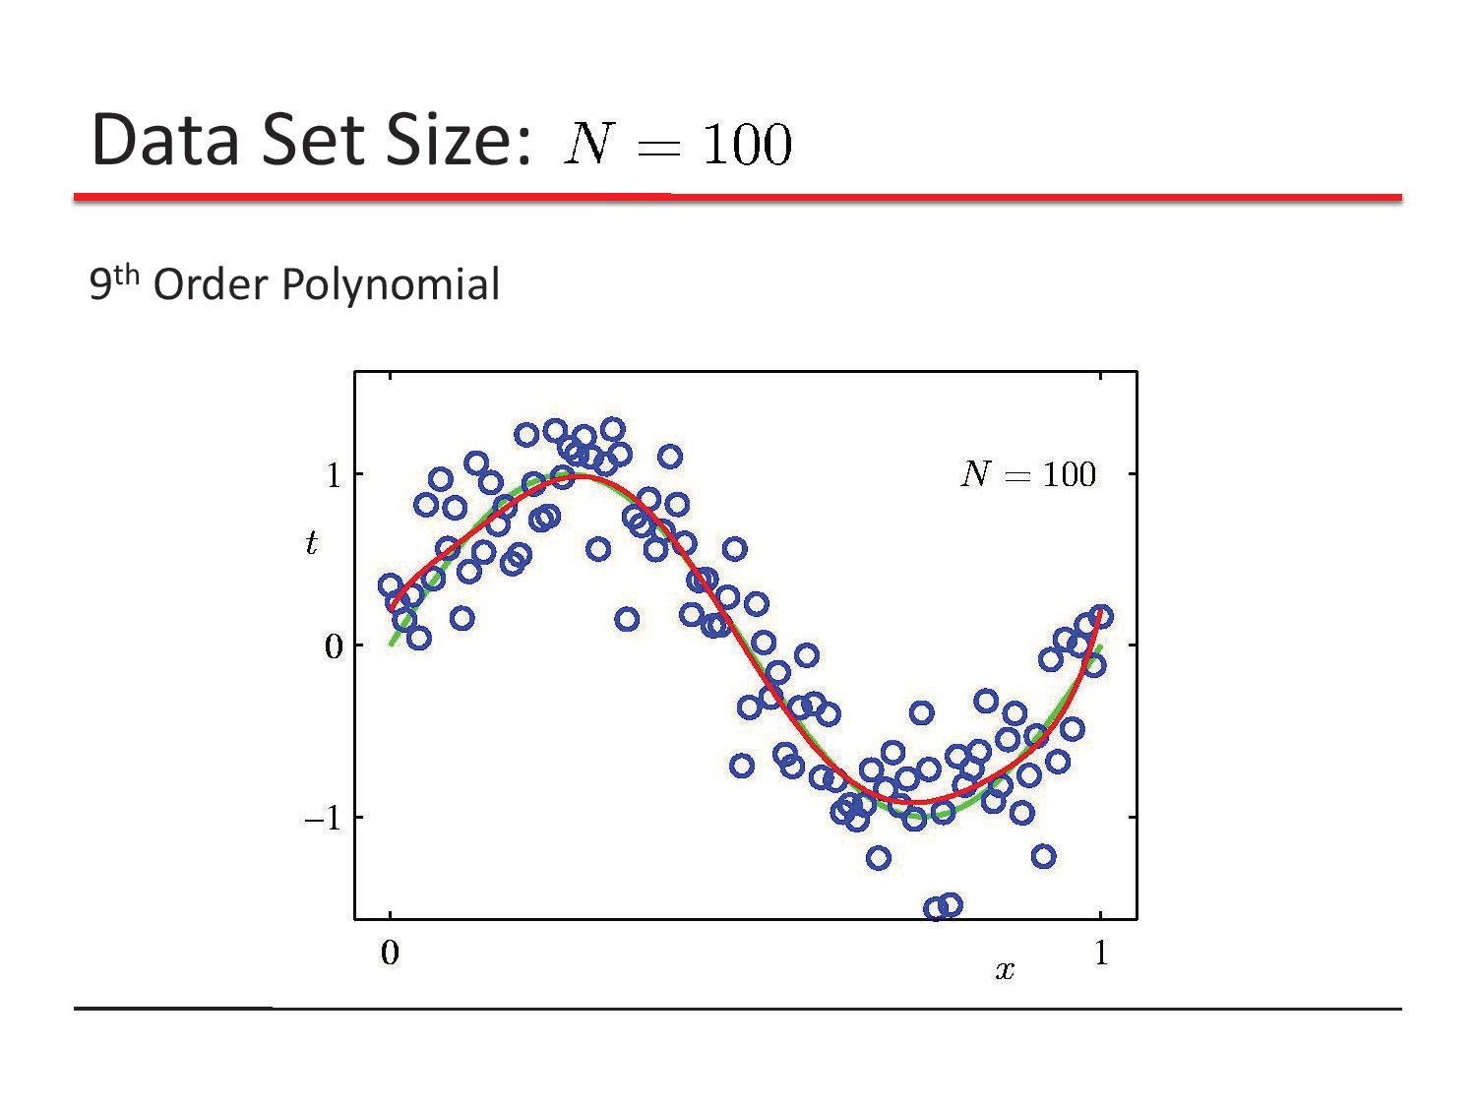

Slide 13
Regularization
Regularization is a technique used to reduce the errors by fitting the function appropriately on the given training set and avoid overfitting.
In context of machine learning, most regularization strategies are based on regularizing estimators. This is done through reducing variance at the expense of increasing the bias of the estimator.
In other words, we could prevent overfitting by penalizing complex models, a principle called regularization.

Slide 14
Regularization
In other words, instead of simply aiming to minimize loss (empirical risk minimization):
minimize(Loss(Data|Model))
we'll now minimize loss+complexity, which is called structural risk minimization:
minimize(Loss(Data|Model)+complexity(model)
Our training optimization algorithm is now a function of two terms: the loss term, which measures how well the model fits the data, and the regularization term, which measures model complexity.
https://developers.google.com/machine-learning/crash-course/regularization-for-simplicity/l2-regularization

Slide 15
Regularization
In other words, instead of simply aiming to minimize loss (empirical risk minimization):
minimize(Loss(Data|Model))
we'll now minimize loss+complexity, which is called structural risk minimization:
minimize(Loss(Data|Model)+complexity(model)
Our training optimization algorithm is now a function of two terms: the loss term, which measures how well the model fits the data, and the regularization term, which measures model complexity.
https://developers.google.com/machine-learning/crash-course/regularization-for-simplicity/l2-regularization

Slide 16
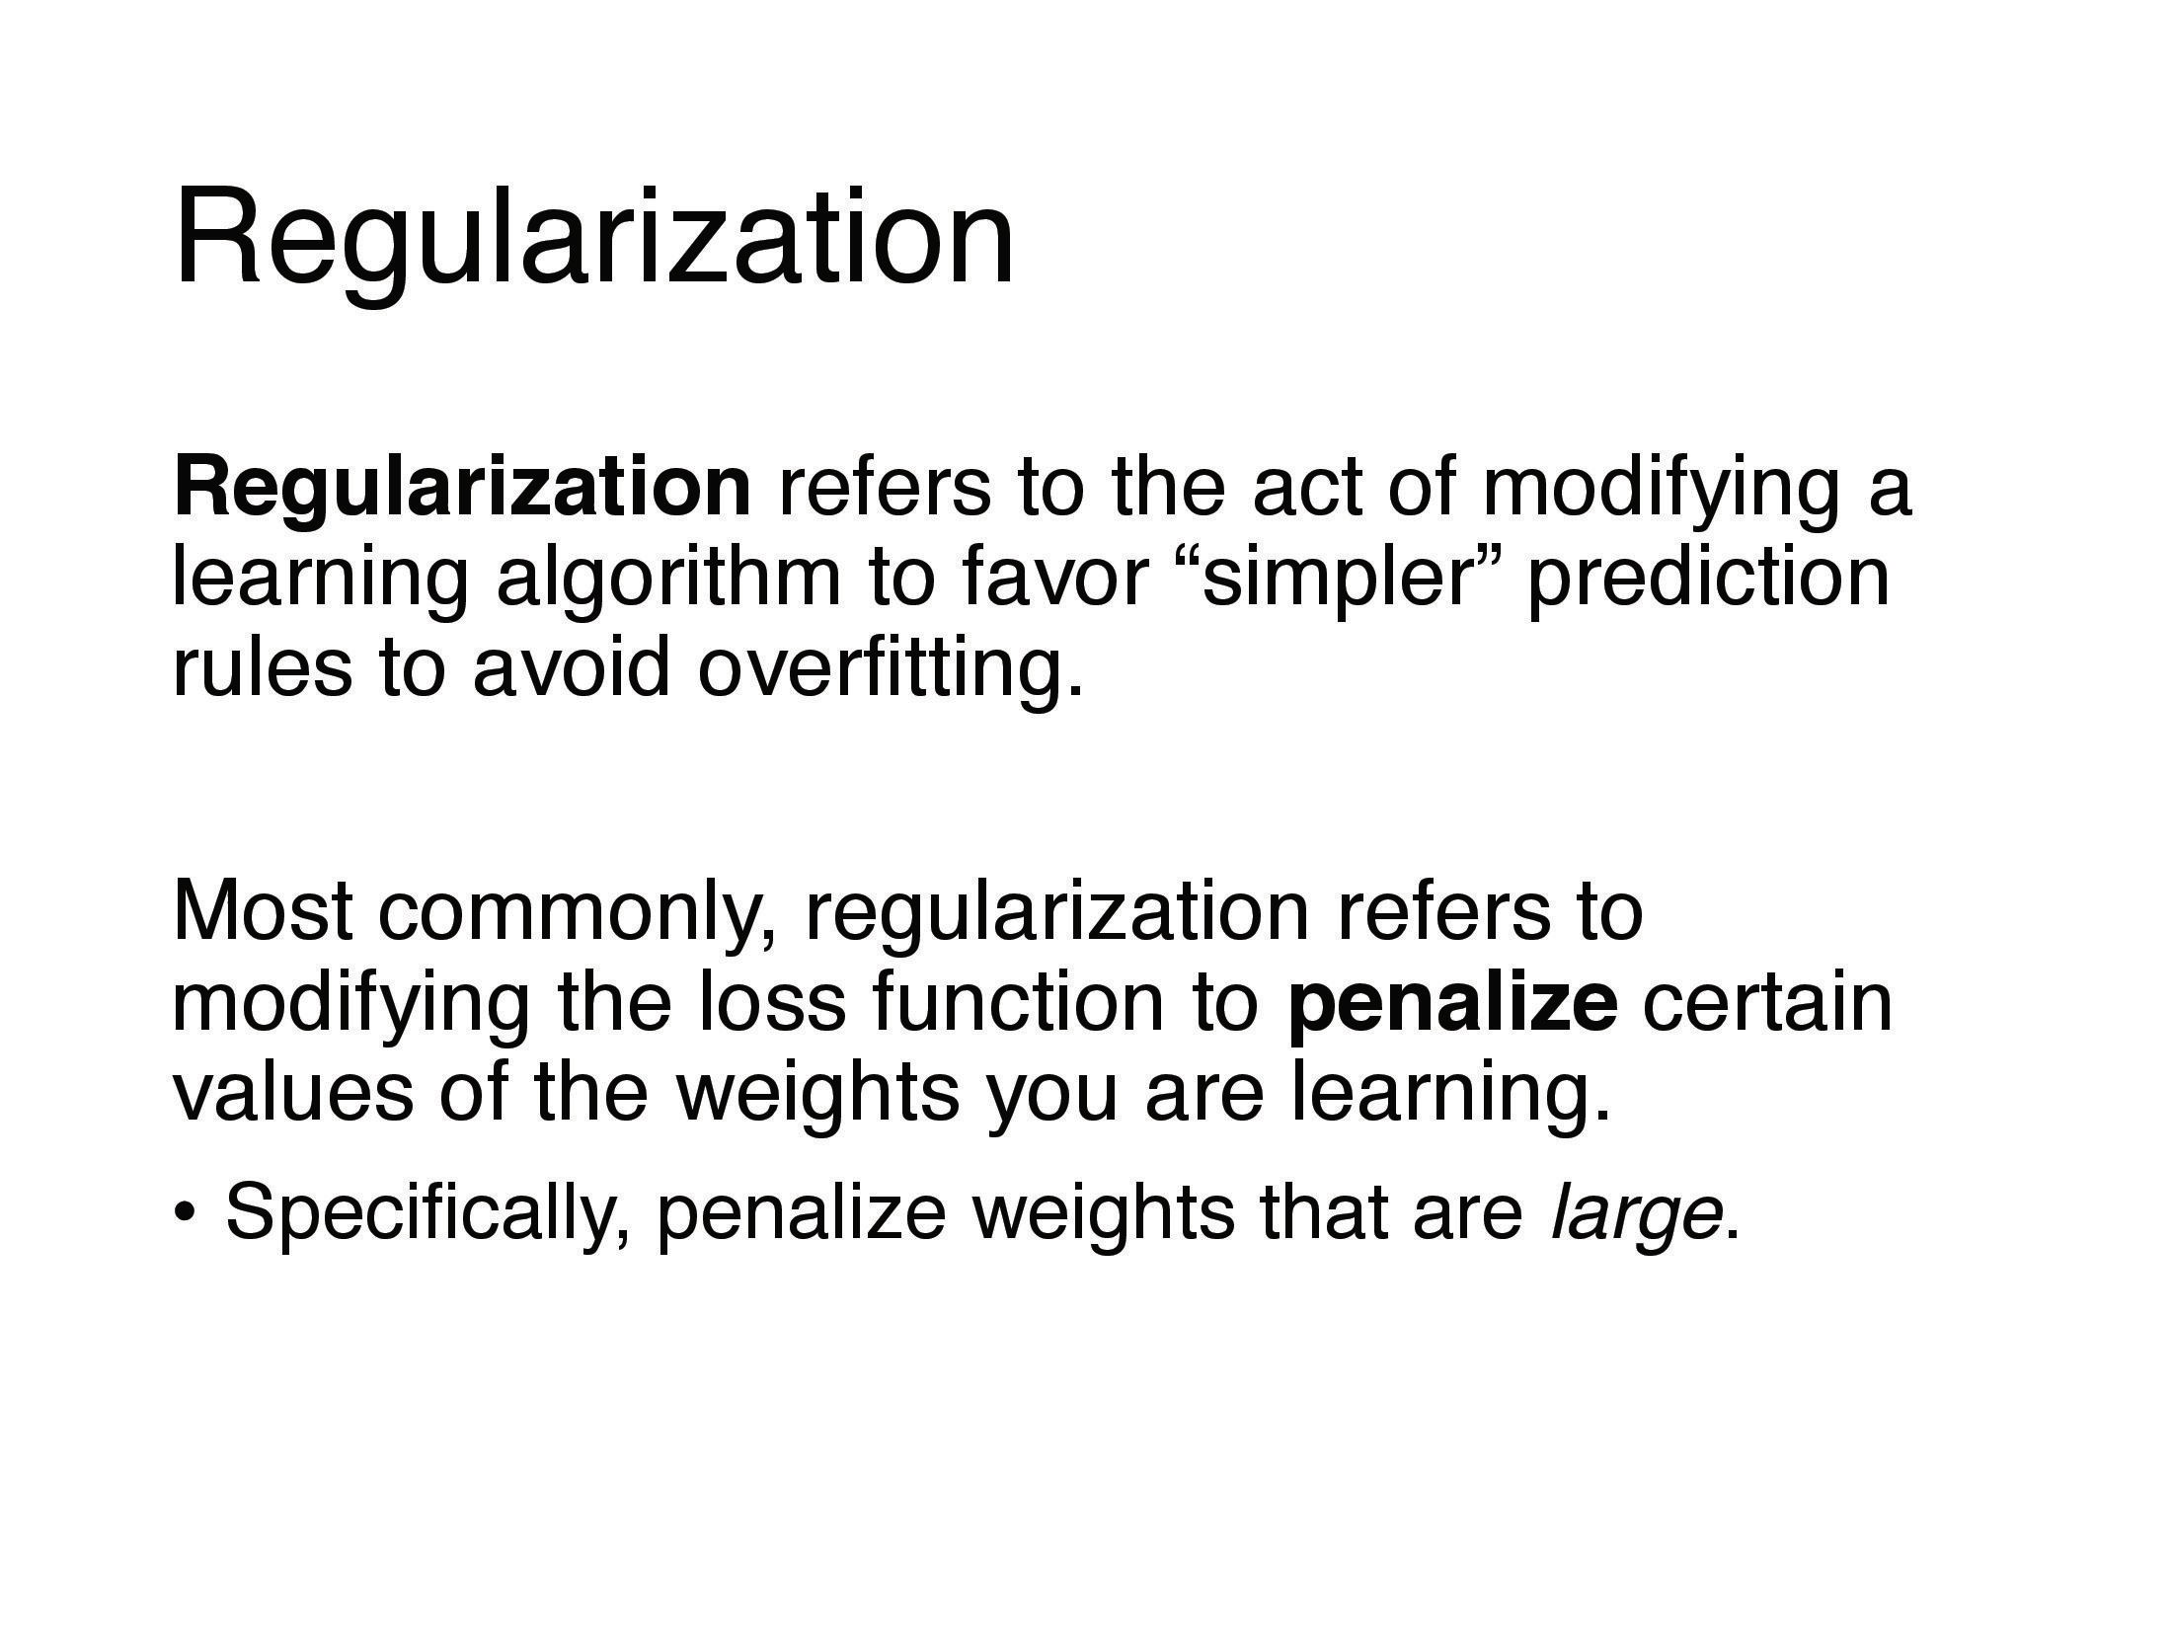

Slide 17
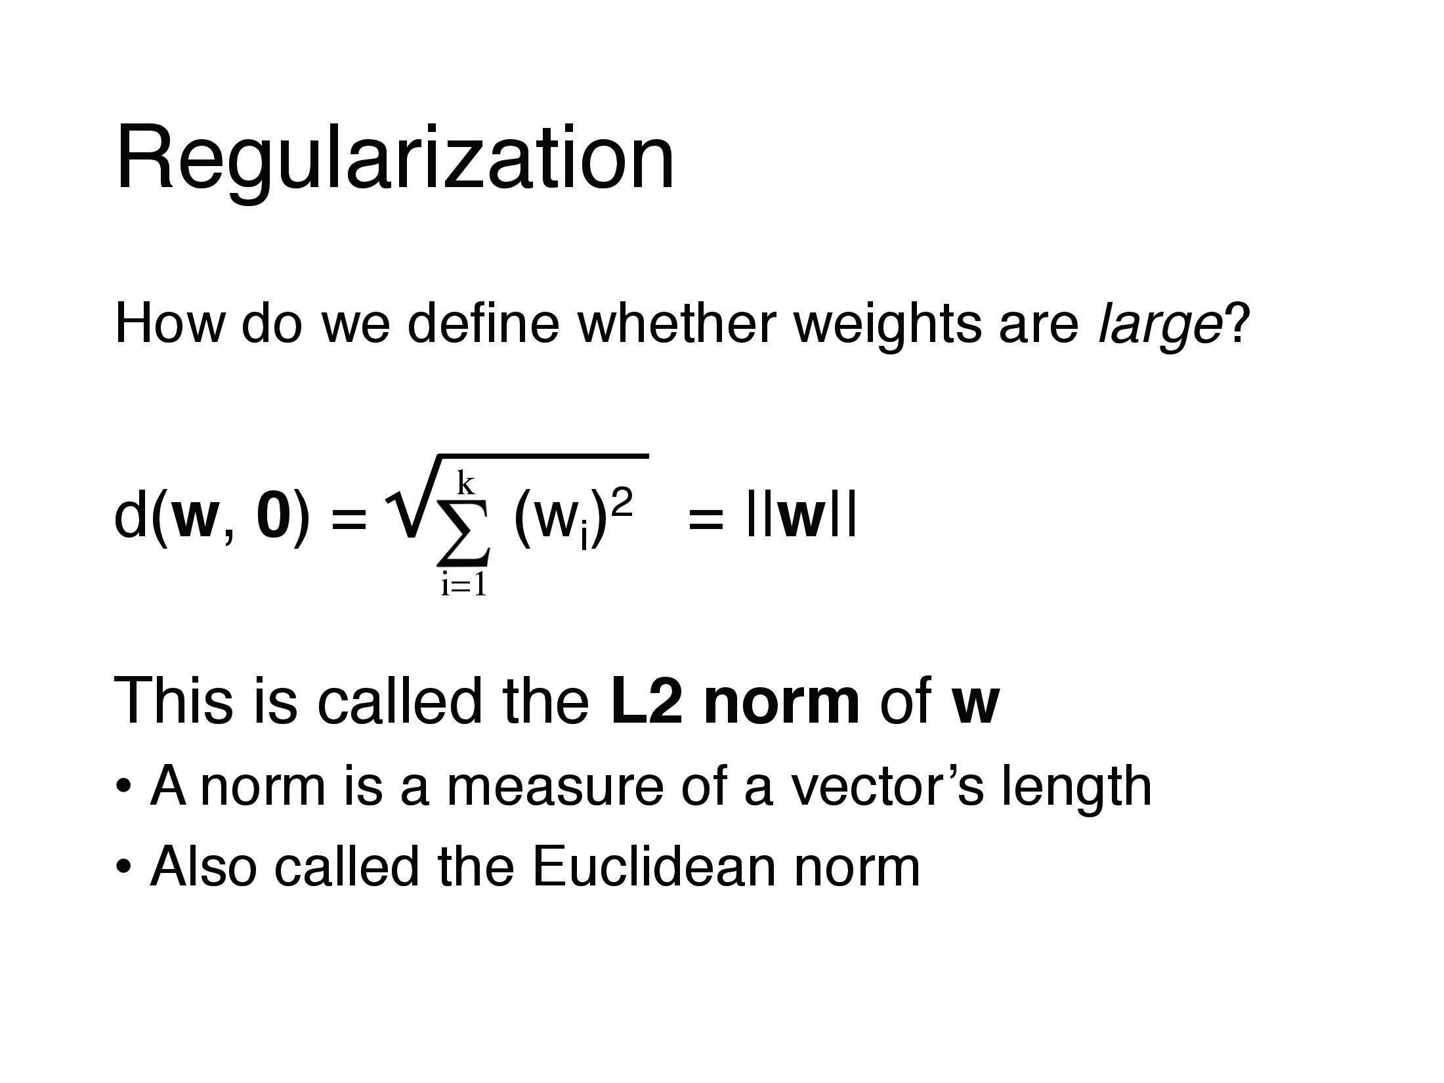

Slide 18
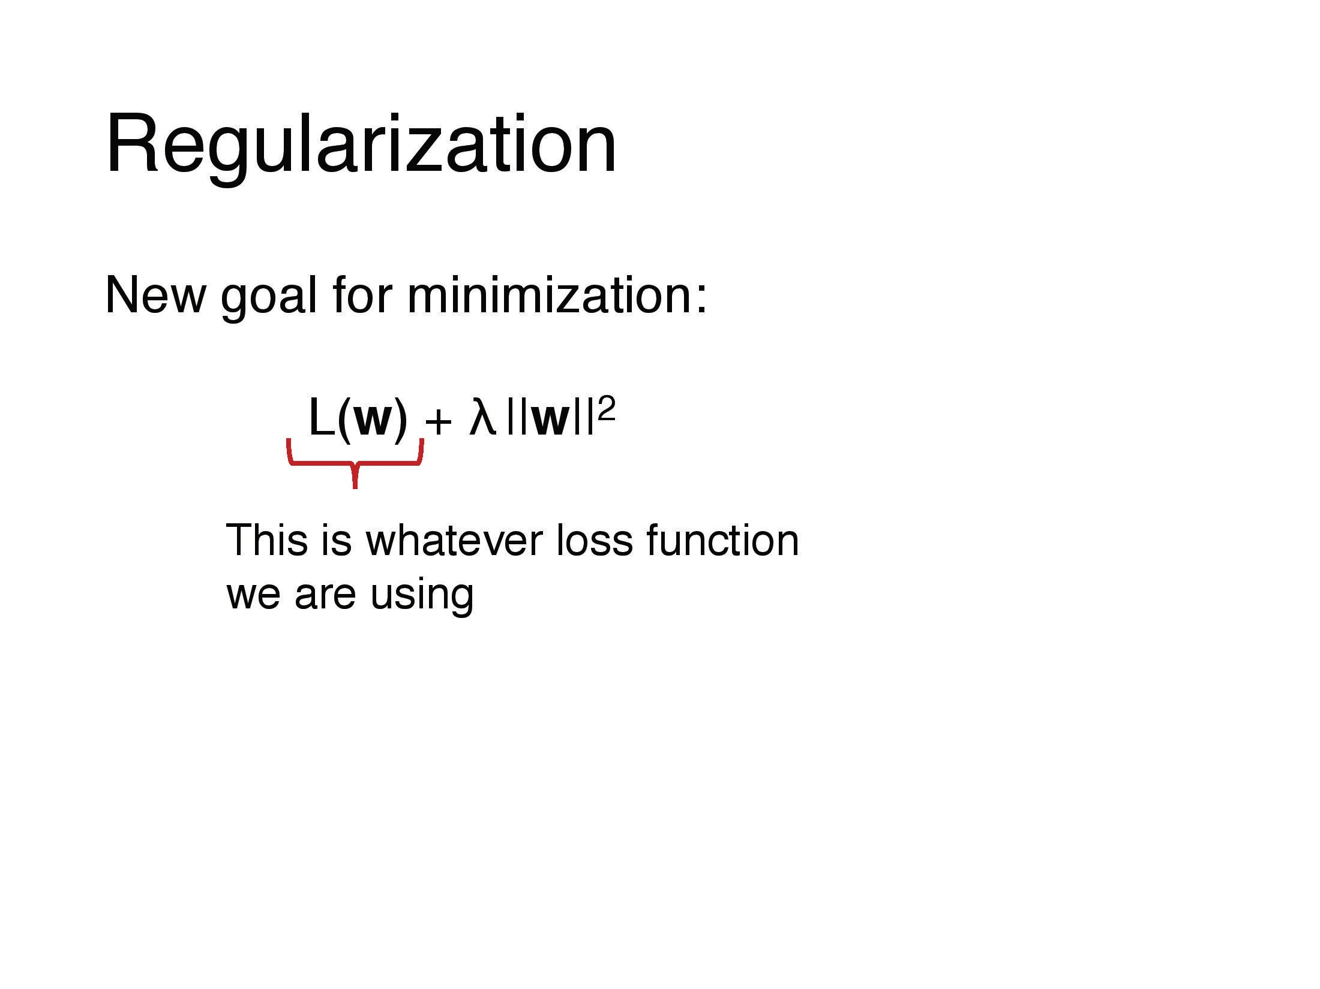

Slide 19
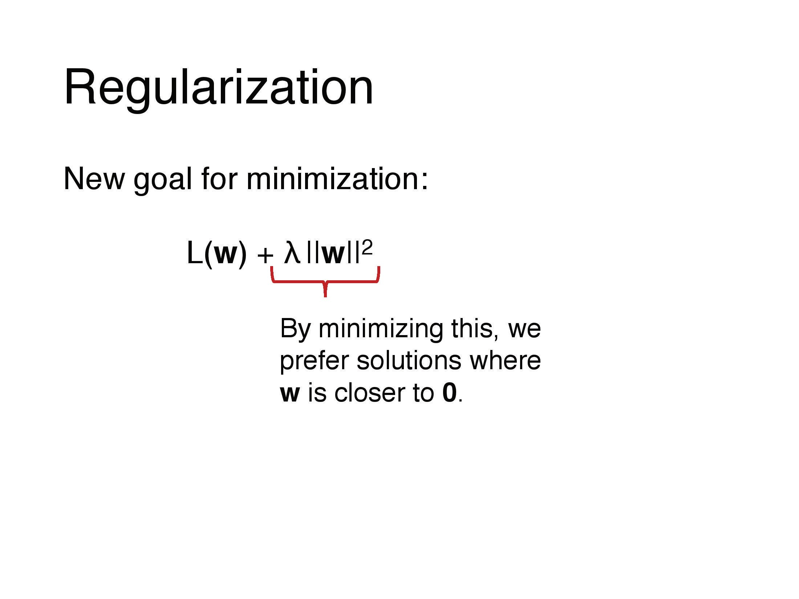

Slide 20
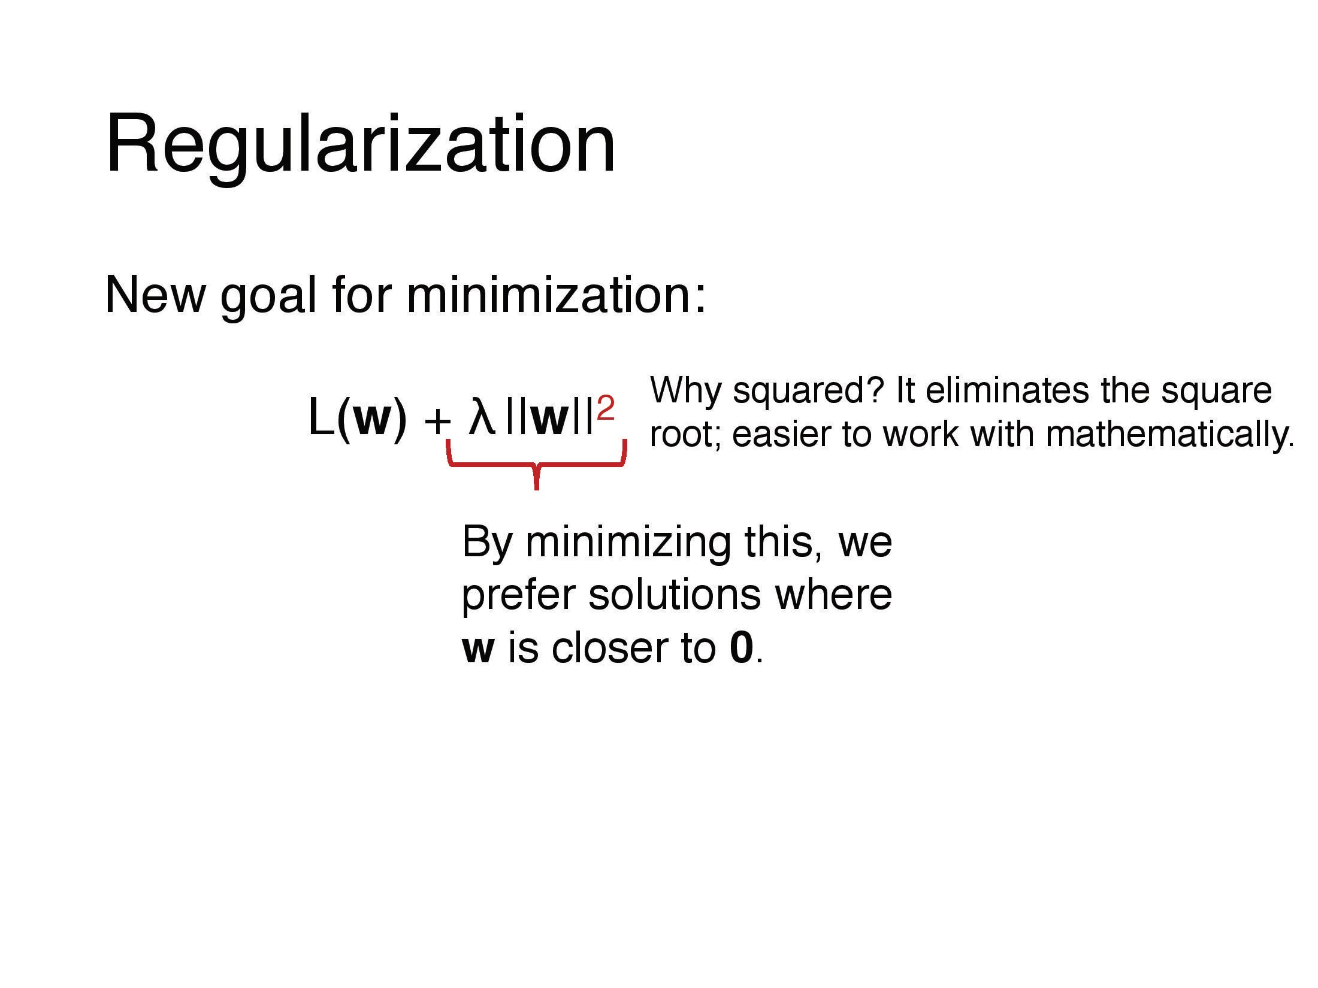

Slide 21
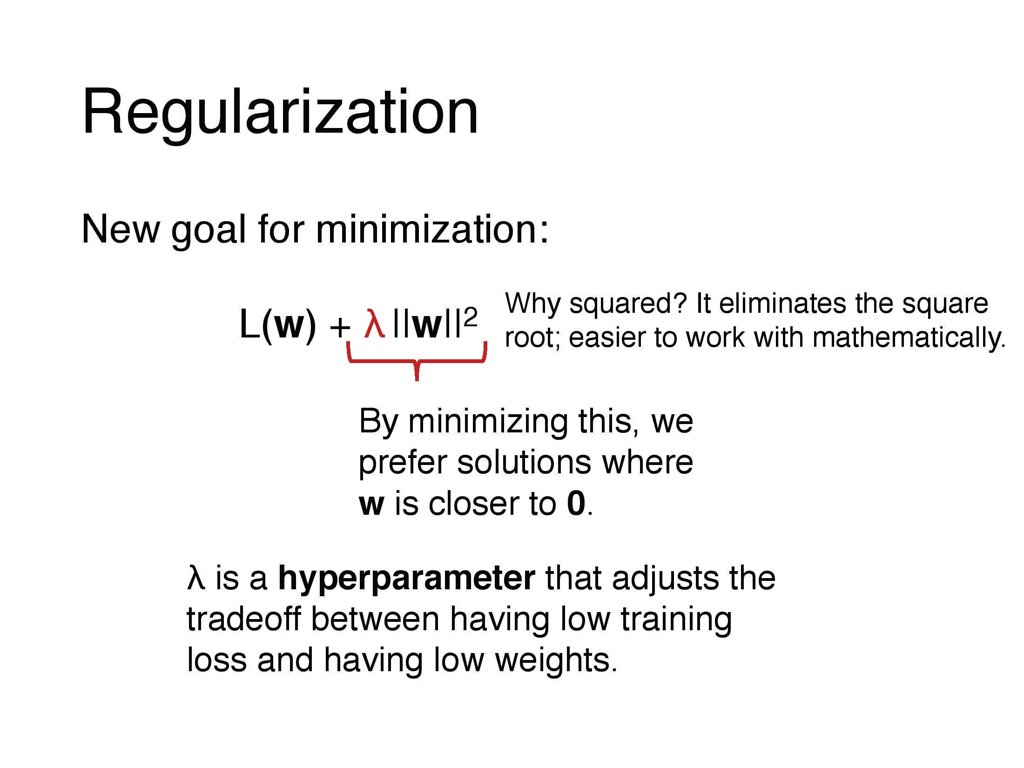

Slide 22
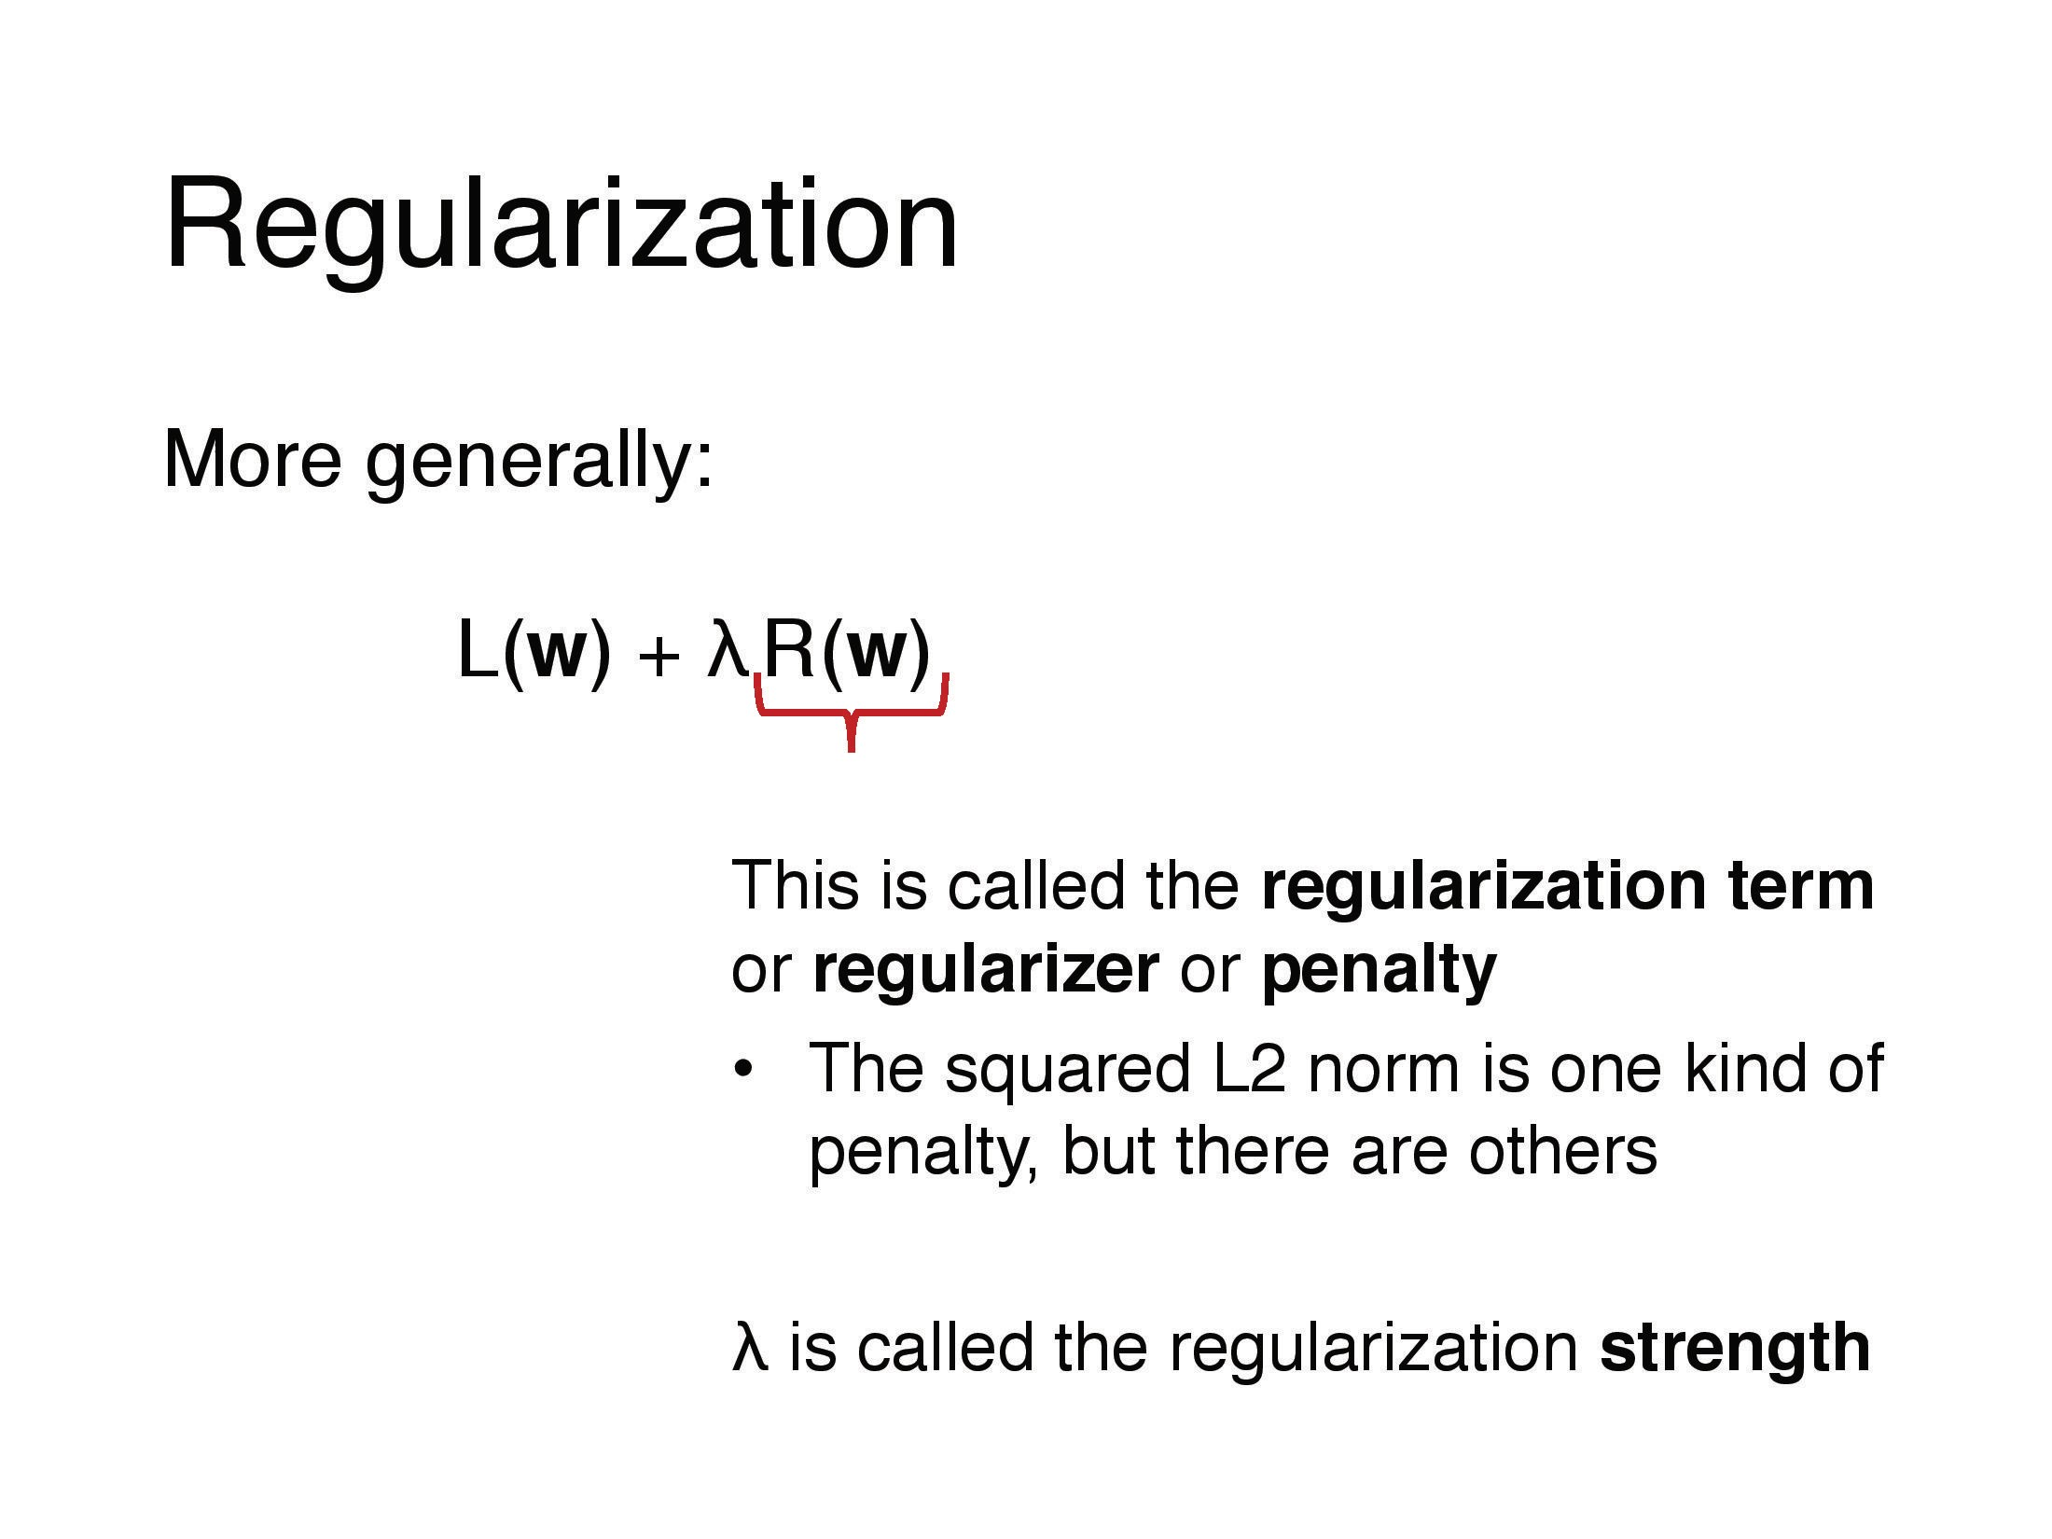

Slide 23
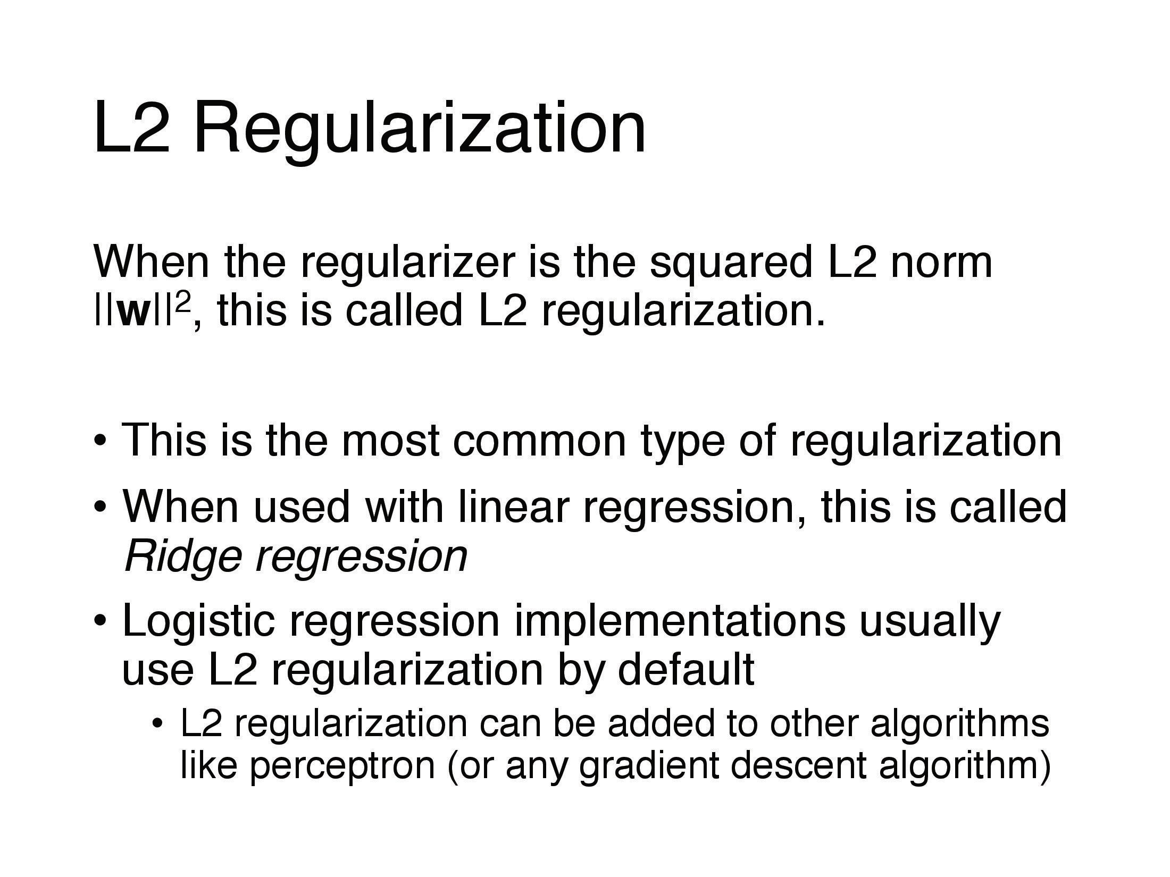

Slide 24
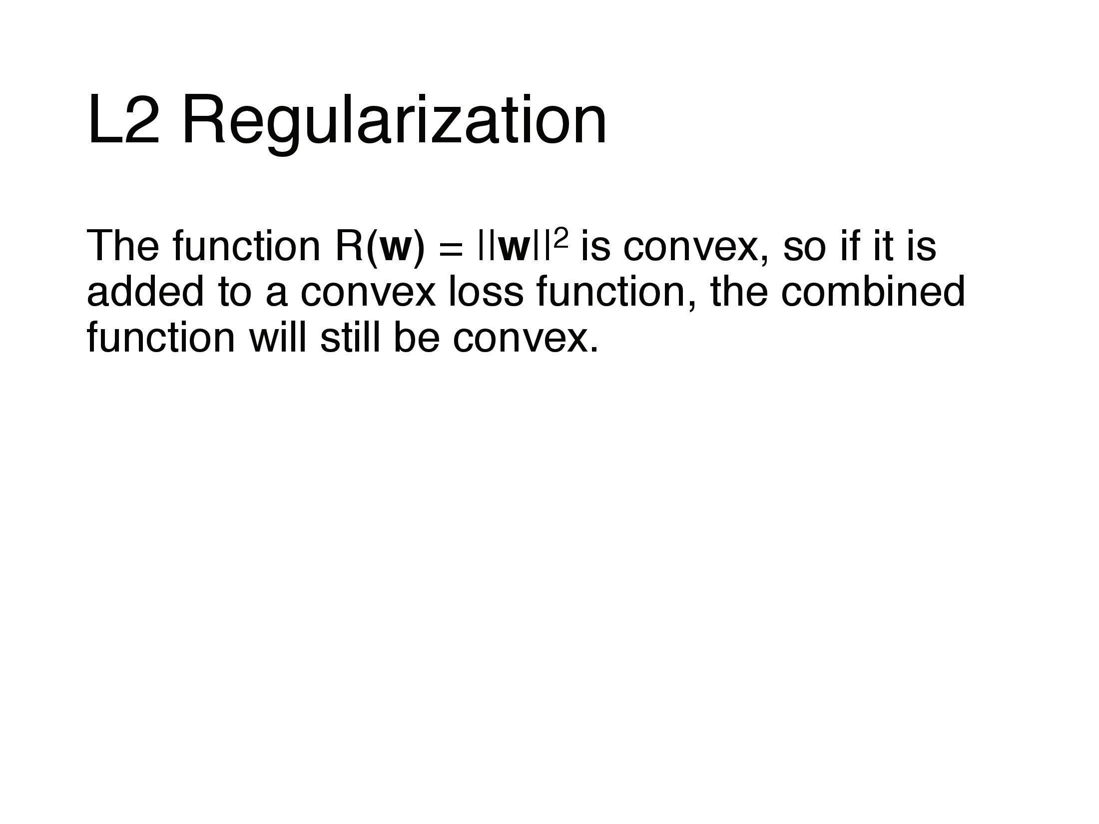

Slide 25
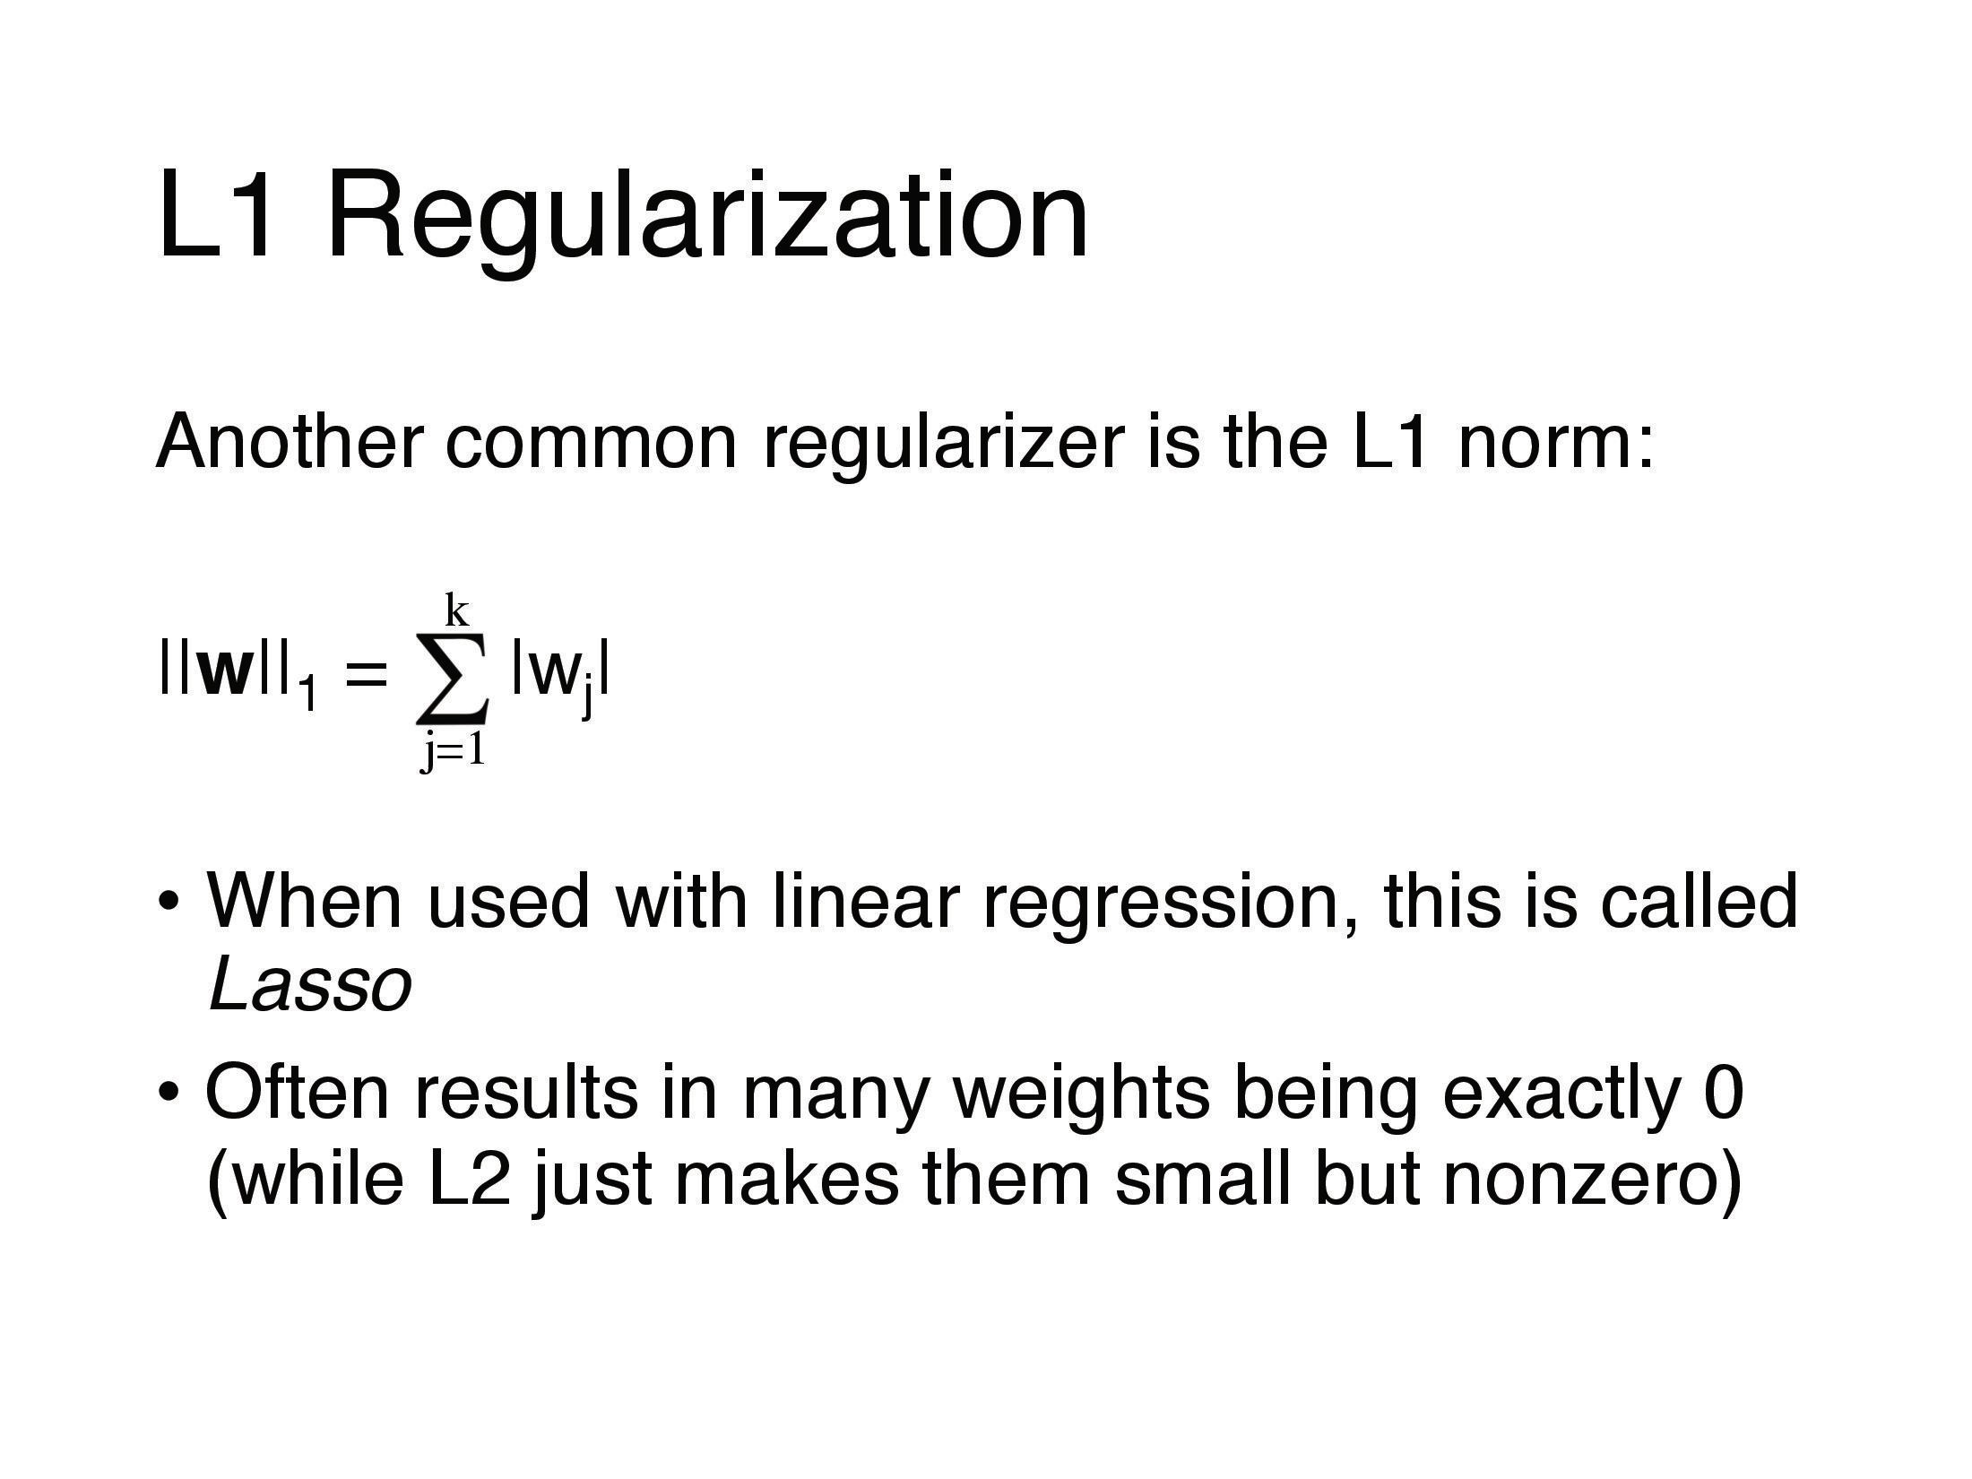

Slide 26
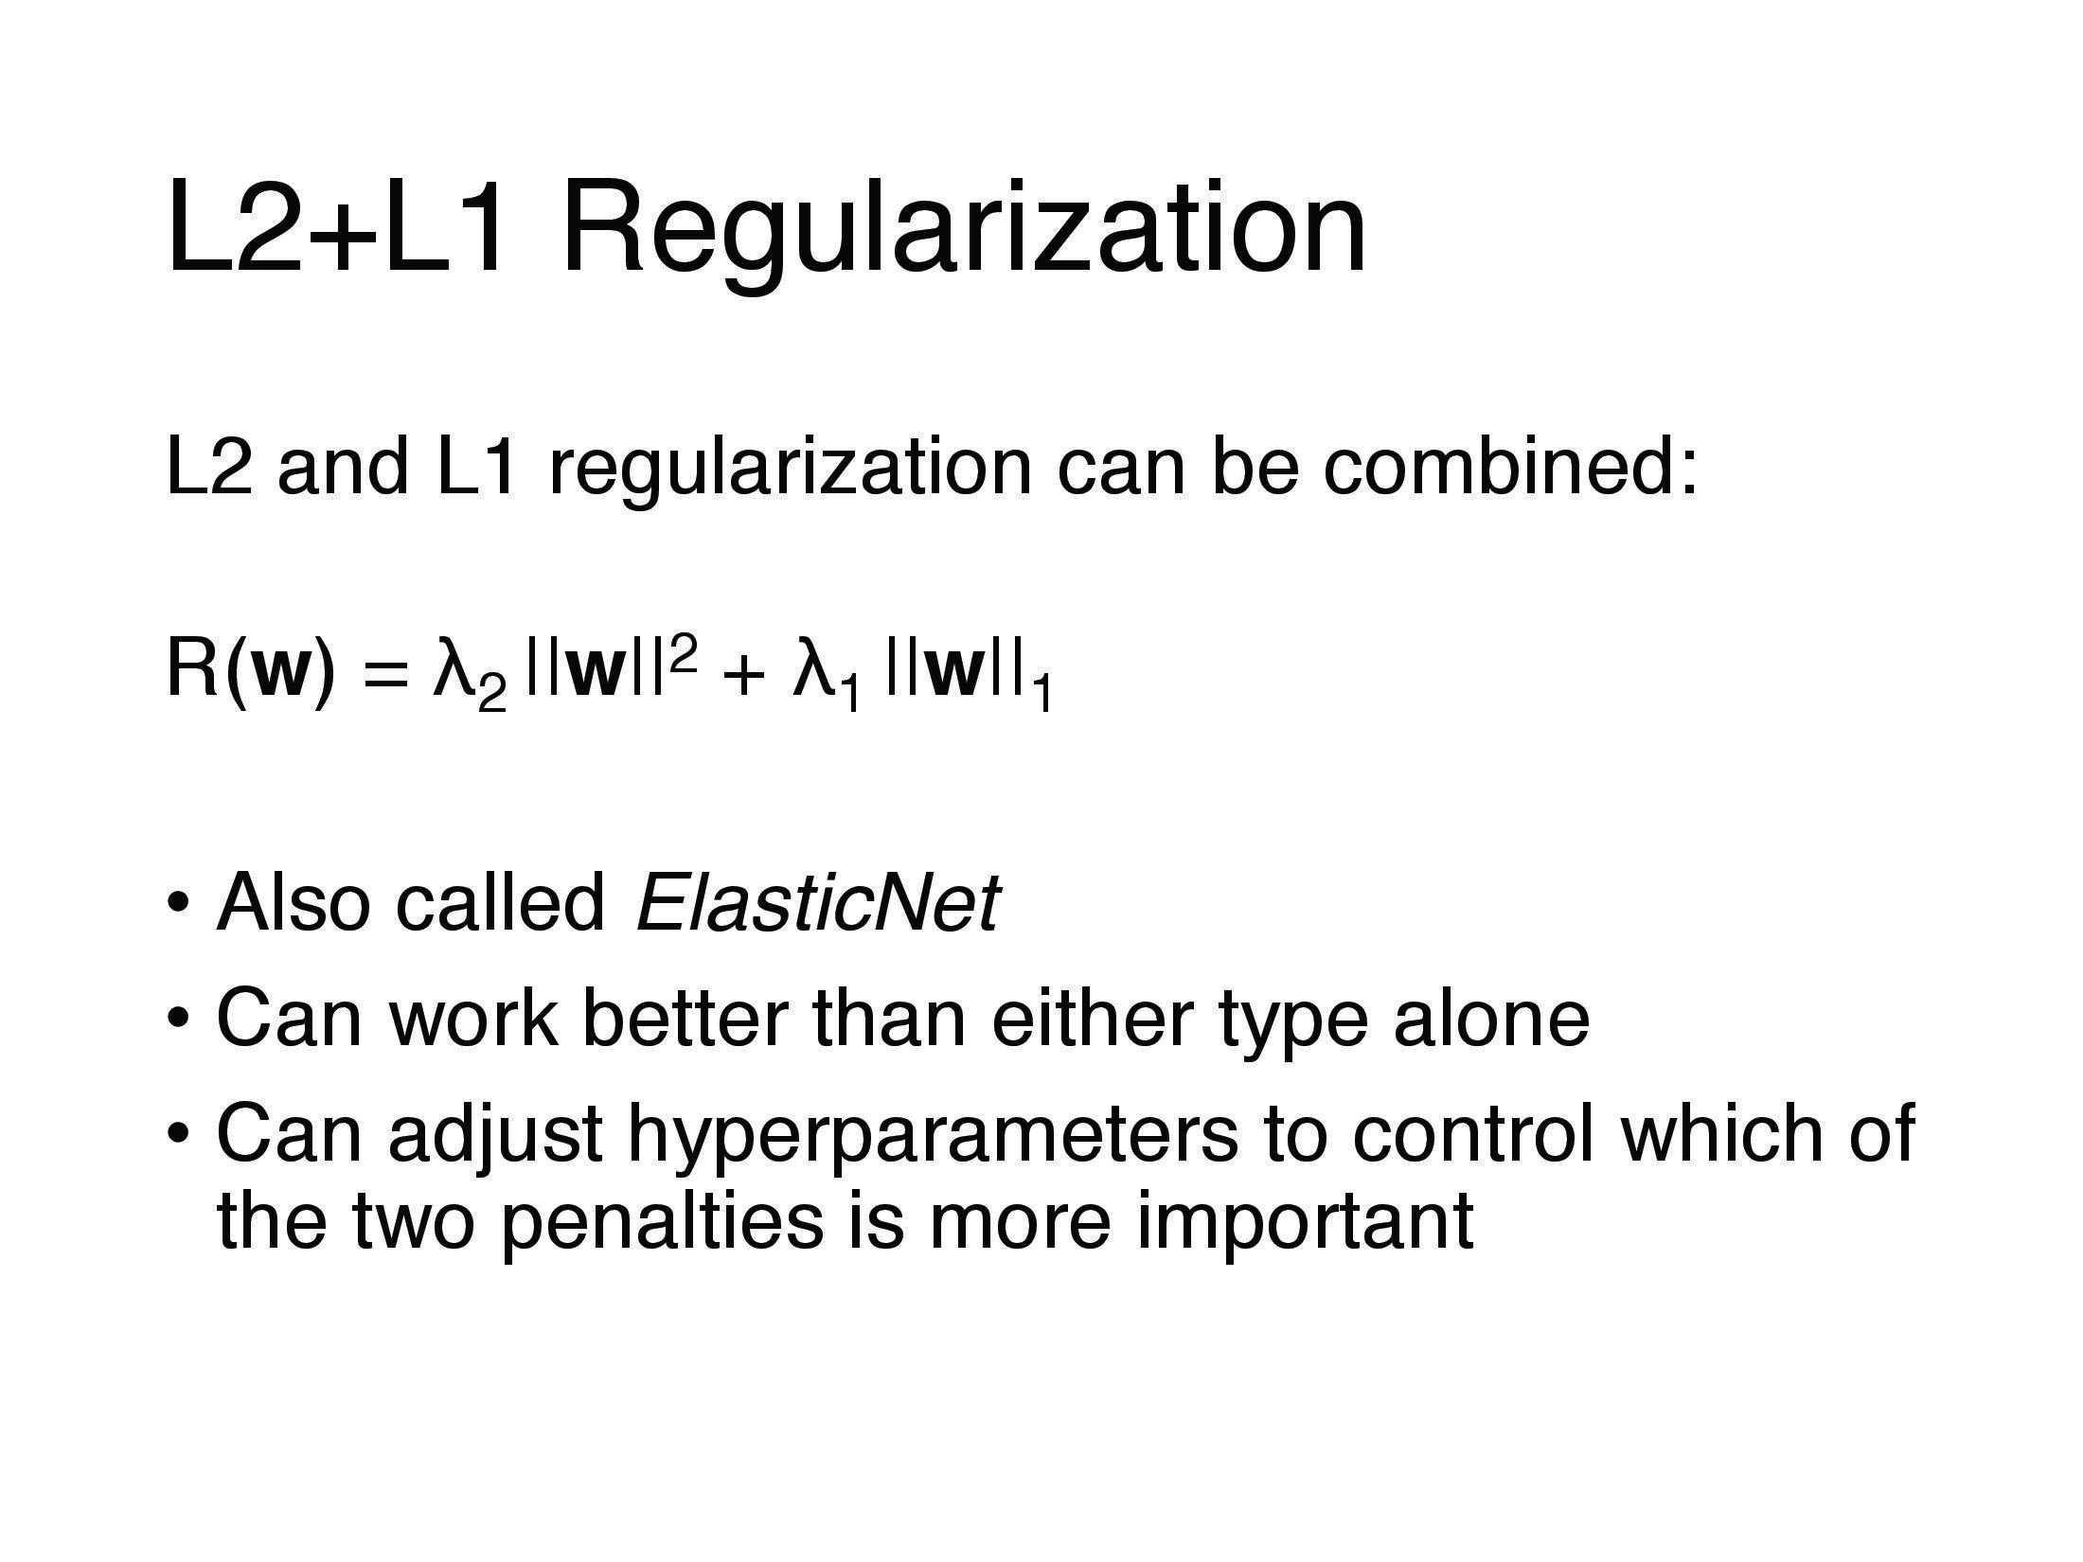

Slide 27
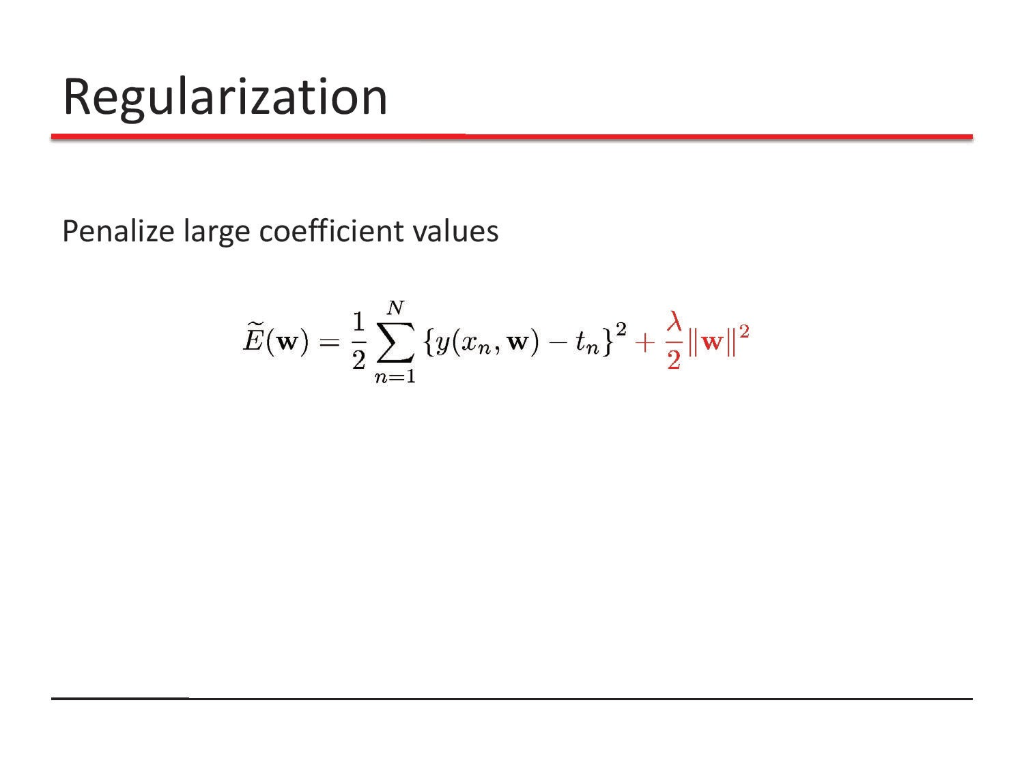

Slide 28
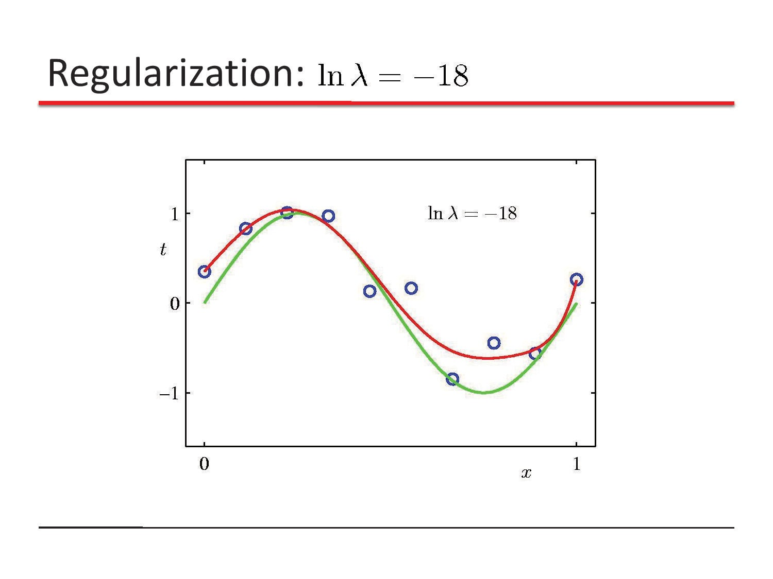

Slide 29
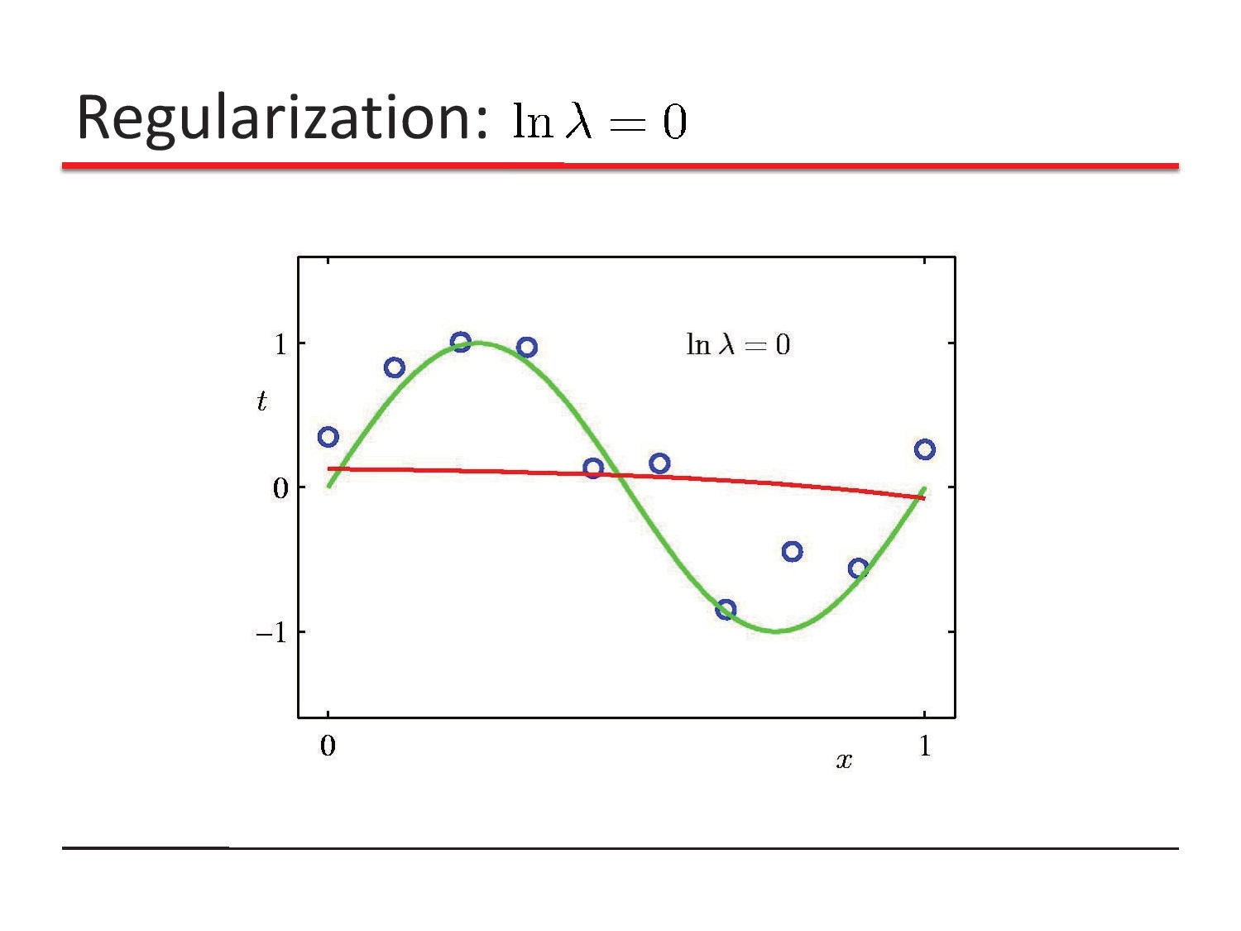

Slide 30
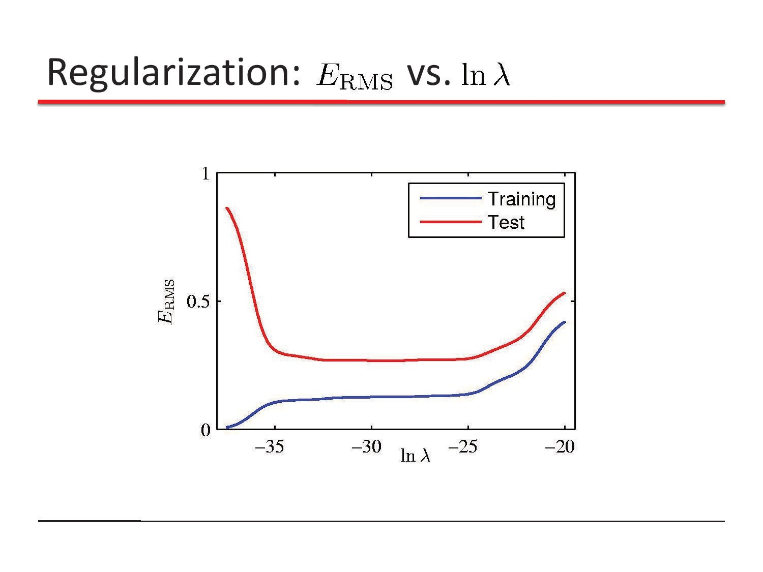

Slide 31
